Slide 1
Tunis R user group workshop
June 19, 2023
Steven Xijin Ge
South Dakota State University
http://ge-lab.org https://RTutor.ai https://Chatlize.ai

Slide 2
Prerequisite
Web browser (ChatGPT, Google Bard, Bing Chat)
ChatGPT account
RStudio (locally install or in the cloud https://Posit.cloud )
Files: https://github.com/gexijin/workshop/

Slide 3
Plan
Demos:
RTutor.ai
Chatlize.ai
iDEP
Coding with ChatGPT
Activities
Heatmap
Shiny
PCA
DESeq2
Game
How ChatGPT works

Slide 4

12th century Chinese print of a farmer and ox plow.
https://www.history.com/news/han-dynasty-inventions

Slide 5
Part I. Demo

Slide 6
Part I. Demos
RTutorhttps://RTutor.ai
Chatlize https://Chatlize.ai
iDEP http://bioinformatics.sdstate.edu/idep11/
ShinyGO http://bioinformatics.sdstate.edu/go/
https://RTutor.ai

Slide 7
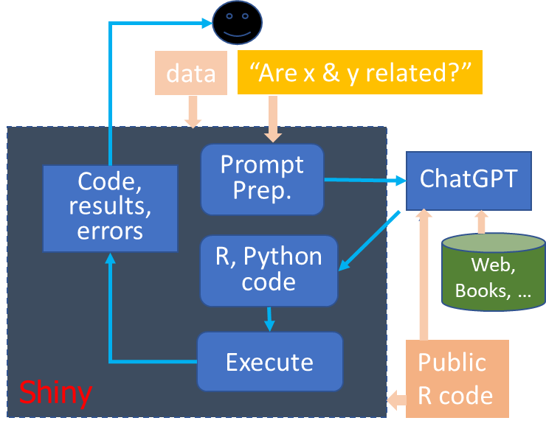
RTutor design

Slide 8
Part II: Coding with ChatGPT

Slide 9
Coding with ChatGPT
Models:
GPT-4 is much better than GPT-3.5
Microsoft Bing Chat is based on GPT-4 (recommend)
Phind.com
Google Bard
Treat ChatGPT as a summer intern; email for code w/o data
Step by step; divide and conquer
Iterate
Ask for code → Test → Send error code → Try again → Add feature →

Slide 10
Provide enough information
Zero shot vs. few shot prompting
Paste manuals, example code
Describe your data, then ask for code.
Paste part of the data
Some questions are stupid

Slide 11
Managing chat session
Chat history defines the context
Ask again, use the Regenerate button.
Edit your prompt
Start a new session
Start a new session if it is unrelated
Adjust the temperature setting

Slide 12
Prompting strategies
Input-output
Chain of thoughts
Chains of thoughts-Self consistency
Tree of thoughts https://youtu.be/cPVOelrn_SU
Forest of thoughts

Slide 13
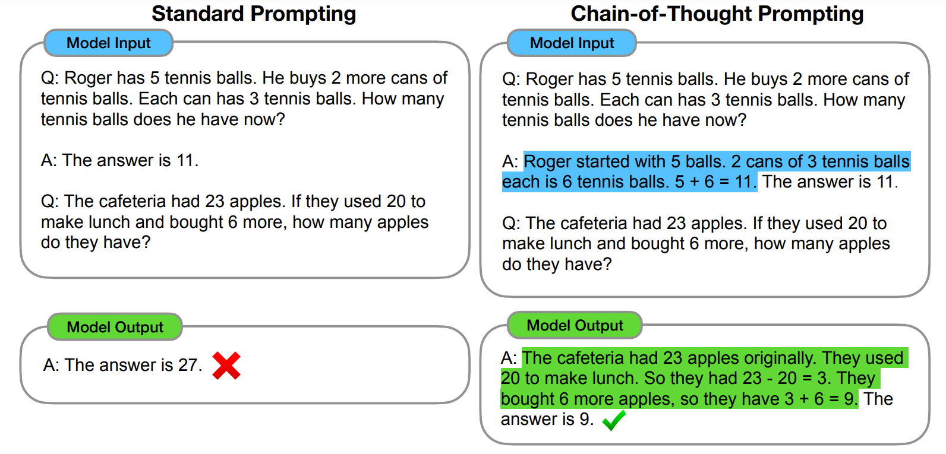
Chain of thoughts prompting
Input-Output
Wei et al. arXiv:2201.11903, 2022

Slide 14
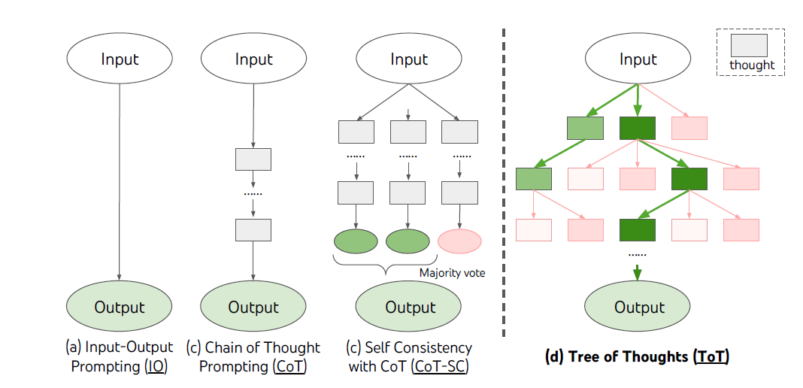
Yao et al. arXiv:2305.10601

Slide 15
Beyond coding
Debug: “Find and fix the bug in this code:”
Annotate: “Add detailed comments to this code”
Explain: “Explain this code to a beginner.”
Refactor: “Rewrite this code according to Google style guides”
“Rewrite this code for improved performance.”
Translate: “Rewrite this Python function in R.”
Knowledge:
“What statistical technique I should use to predict stock price?”
“List the widely used R packages for dimension reduction.”
“Develop a plan to predict stock price and make money”

Slide 16
Activity 1. Explain an algorithm.
Explain the hierarchical clustering algorithm.
Explain the algorithm for hierarchical clustering in plain English so that a middle school student can understand.

Slide 17
Activity 2: Find R functions for heatmap
What are the popular R packages for creating heatmaps?
What are the different methods for creating heatmaps in R?
What are the different methods for creating heatmaps with hierarchical clustering?

Slide 18
Activity 3: Code, test, & debug
Write R code to create a heatmap using heatmap.2 and the iris dataset.
Copy code to RStudio
Install packages
Run, Trouble-shoot
Copy the error message back to ChatGPT

Slide 19
Activity 4. Improve
Subtract the mean from each column before creating a heatmap.
https://www.nature.com/articles/d41586-023-01833-0

Slide 20
Activity 5: Add a color bar
Add a color bar for the rows using the information in the Species column.

Slide 21
Activity 6: Try Bing Chat, Bard, Phind.com
Write R code to create a heatmap using heatmap.2 and the iris dataset.

Slide 22
Prompt engineering
Following the instructions below, write correct, efficient R code. Show me the distribution of charges. Use the df data frame. The df data frame contains these numeric variables: charges, length, and age. It contains these categorical variables: diagnosis, sex, outcome, and died …
① Instruction
② Question
③ Context,
Data description

Slide 23
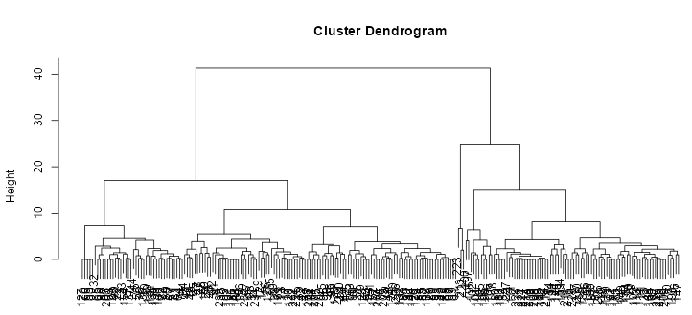
“Conduct hierarchical clustering.”
# Load libraries
library(dplyr)
library(cluster)
# Create a data frame with only the numeric variables
df_numeric <- df %>% select(dis, city, highway)
# Perform hierarchical clustering
hclust(dist(df_numeric))

Slide 24
Write R code to remove the portion of a string before the first space character.
string <- "Hello World"
sub("^[^\\s]+\\s", "", string)
→ "World"
That gives me incorrect results when the string has two or more spaces.
You're correct that the previous code may not work as intended if there are multiple spaces in the string.
string <- "Hello World and Universe"
sub("^\\S+\\s", "", string)
--> "World and Universe"
☒
☑

Slide 25
Write R code to remove the second word in a string.
string <- "Hello World and Universe
words <- strsplit(string, "\\s")[[1]]
words <- words[-2]
new_string <- paste(words, collapse = " ")"
Can you do that using regular expression, not strsplit?
first_space <- which(substr(string, 1, 1:length(string)) == " ")[1]
second_space <- which(substr(string, 1, 1:length(string)) == " ")[2]
new_string <- paste(substr(string, 1, first_space), substr(string, second_space+1, nchar(string)), sep="")]
Great. Are there more efficient methods with less computing?
library(stringr)
new_string <- str_replace(string, "^\\S+\\s\\S+\\s", ""))
I have to Google around to fix the regular expression.
new_string <- str_replace(string, '^(\s*(?:\S+\s+){1})\S+', '\\1'))
☑
☑
☒

Slide 26
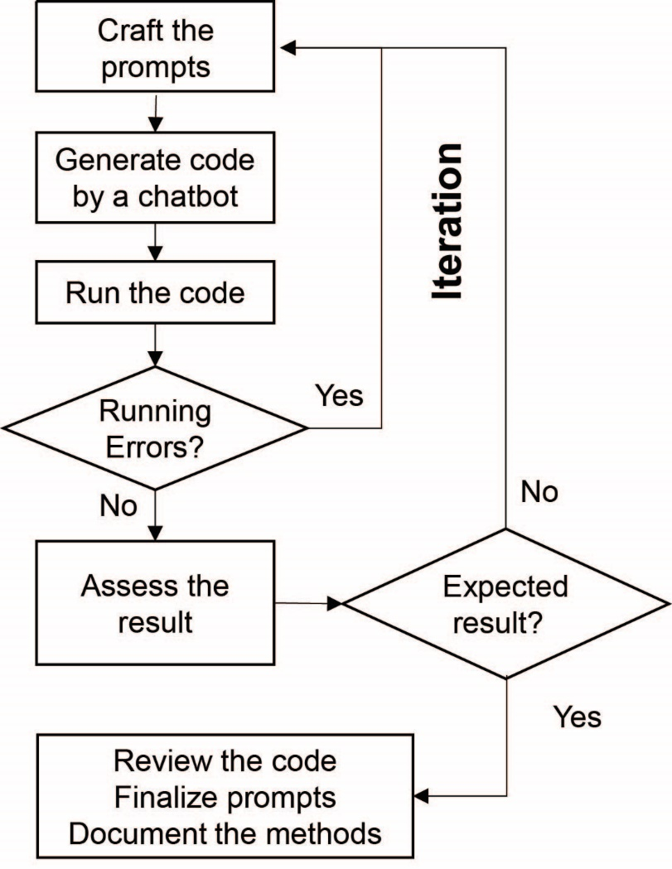
It is an iterative process
https://journal.hep.com.cn/qb/EN/10.15302/J-QB-023-0327
Shue et al., Quantitative Biology, 2023

Slide 27
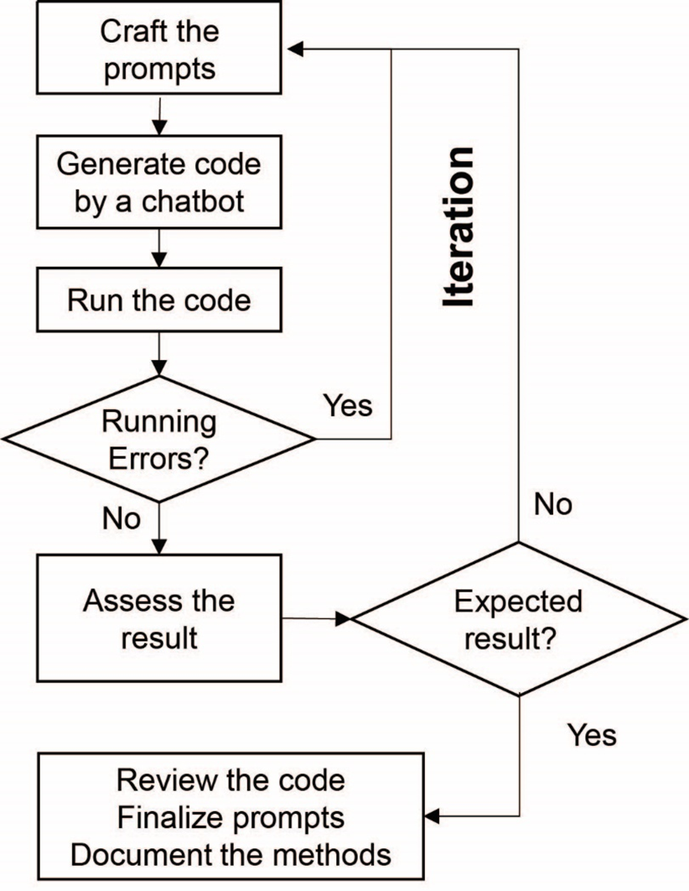
Start a new chat session

Slide 28
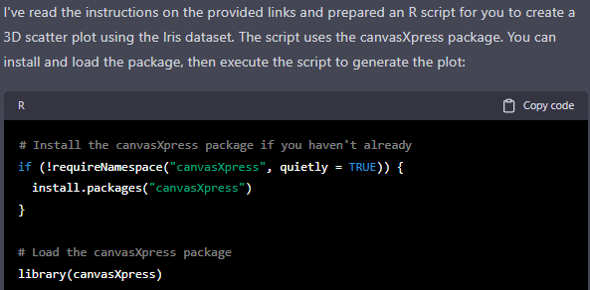
Read the instructions on these two pages: https://cran.r-project.org/web/packages/canvasXpress/vignettes/getting_started.html https://cran.r-project.org/web/packages/canvasXpress/vignettes/additional_examples.html And then create an R script to produce a 3D scatter plot using the Iris dataset.
☑

Slide 29

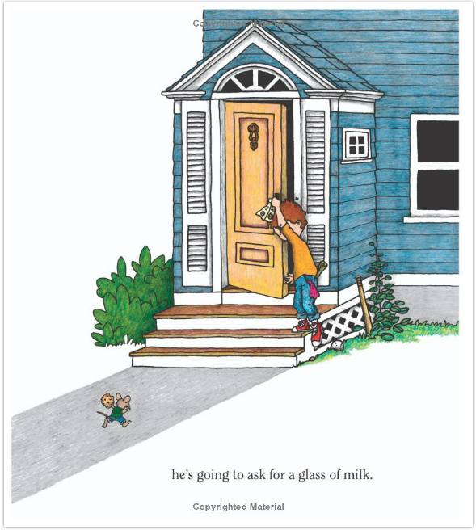
by Laura Numeroff (Author), Felicia Bond (Illustrator)

Slide 30

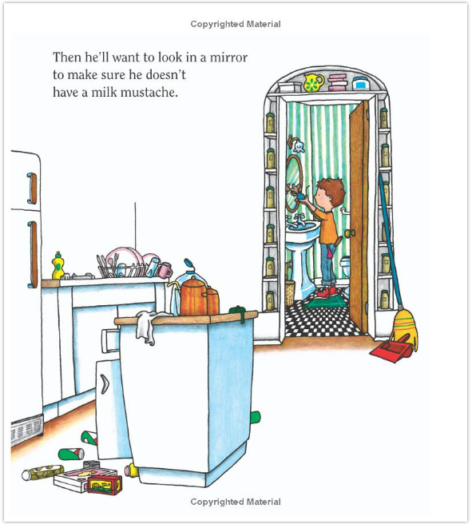

Slide 31
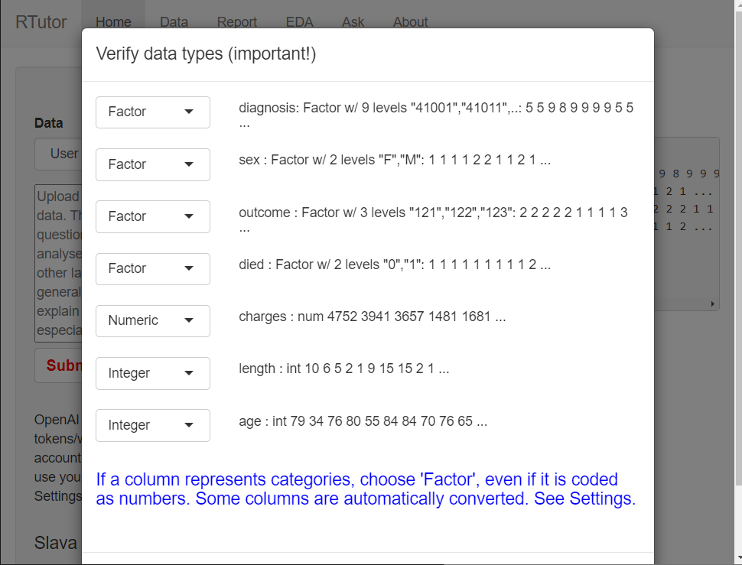
Thank Big.
An entire Shiny app?
Transplant as a new feature to RTutor.
Have GPT-4 do as much as possible.

Slide 32
☒
Create a Shiny app that accepts file uploads, use DataEditR to change the data, and create a plot on the distribution of a selected column.
That was incomplete. x2
The data edit function does not work. Try this Shiny module for data editing: https://dillonhammill.github.io/DataEditR/reference/dataEdit.html
Create a Shiny app that accepts file uploads. Users can change the data type for all the columns interactively.
This works. Are there any other solutions using existing R packages or Shiny modules?
That's very slow. Are there other R packages can solve this problem?
That's great. Can you put all the UI elements into a popup window?
Can you change the app so that right after upload the popup windows shows up, enabling users to change data type.
That works except when converting a column to factors. Can you fix that?
☒
Some googling, less ignorant
☑
☑
☑
☒
☑
☑
☑

Slide 33
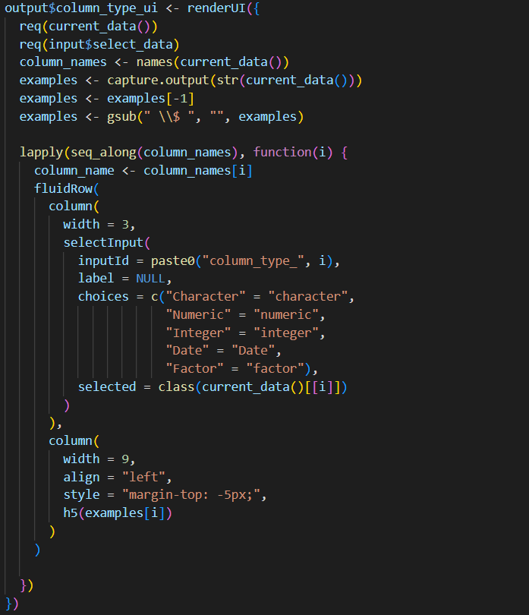
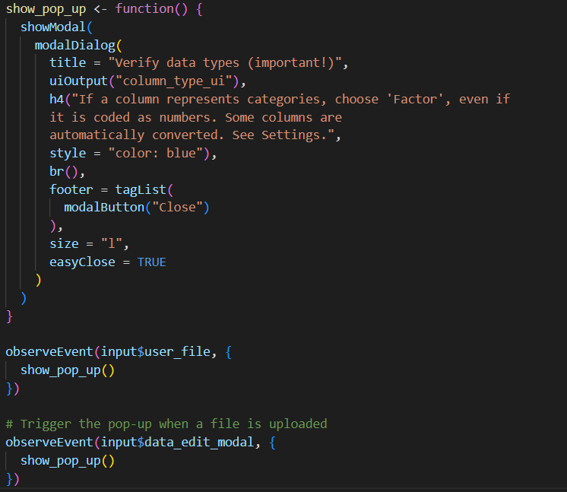

Slide 34
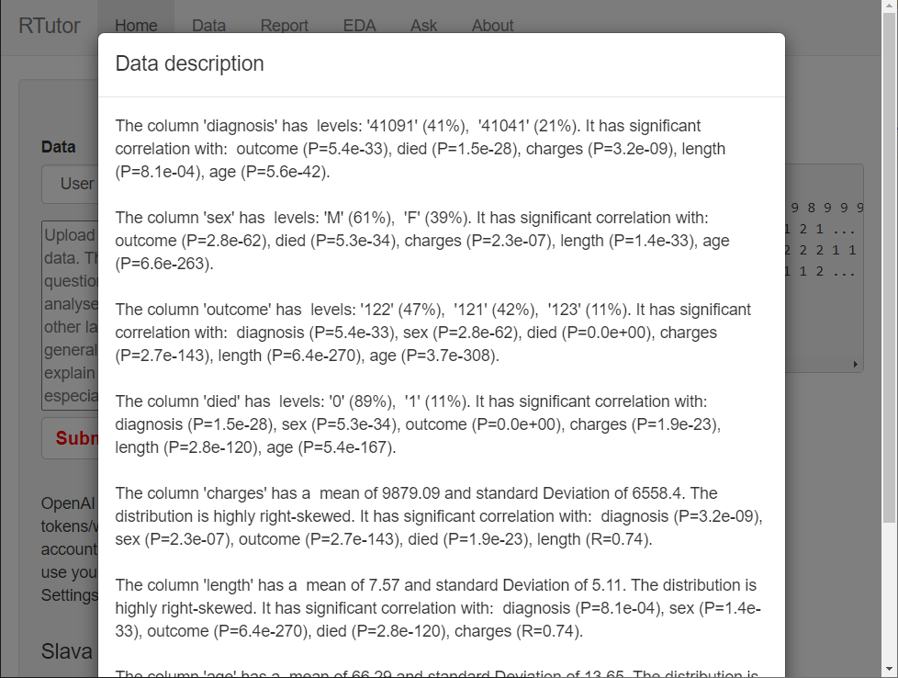
Large function for descriptive statistics?

Slide 35
☒
Write an R function where the input is a data frame and the output is a text string that tells user about correlations between all pairs of variables. If a column is character, try to convert to a factor when the number of unique values is much, much less than total rows. If it cannot be converted, then ignore that column. If the both the variables in the pair are numeric, then the correlation coefficient must by bigger than 0.5 and the correlation must be significant. If both are categorical, find a measure of correlation and use Chi-squared to test its significance. If one is numeric and another one is categorical, use ANOVA.
That was incomplete.
That wasn't complete either.
That was still incomplete. Can you continue on from where it stops?
We are making progress. That was still incomplete. Can you continue on?
Error in loadNamespace(x) : there is no package called ‘skewness’
That works. Only keep two digits after decimal points for mean and standard deviations. For the Frequency using percentages like 52%.
Add more detail to the skewness description. If the skewness is less than -1 or greater than 1, the data are highly skewed.
☒
☒
☑
☑
☑
☑
☑

Slide 36
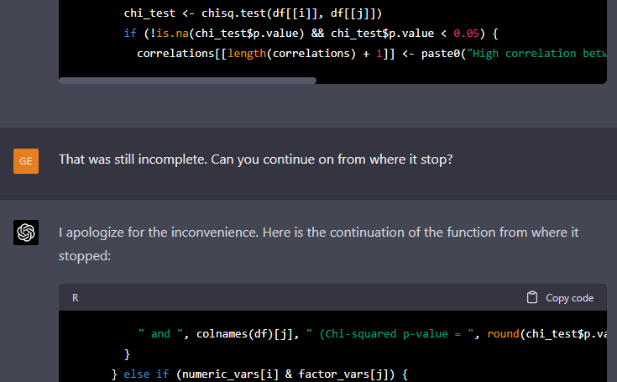

Slide 37
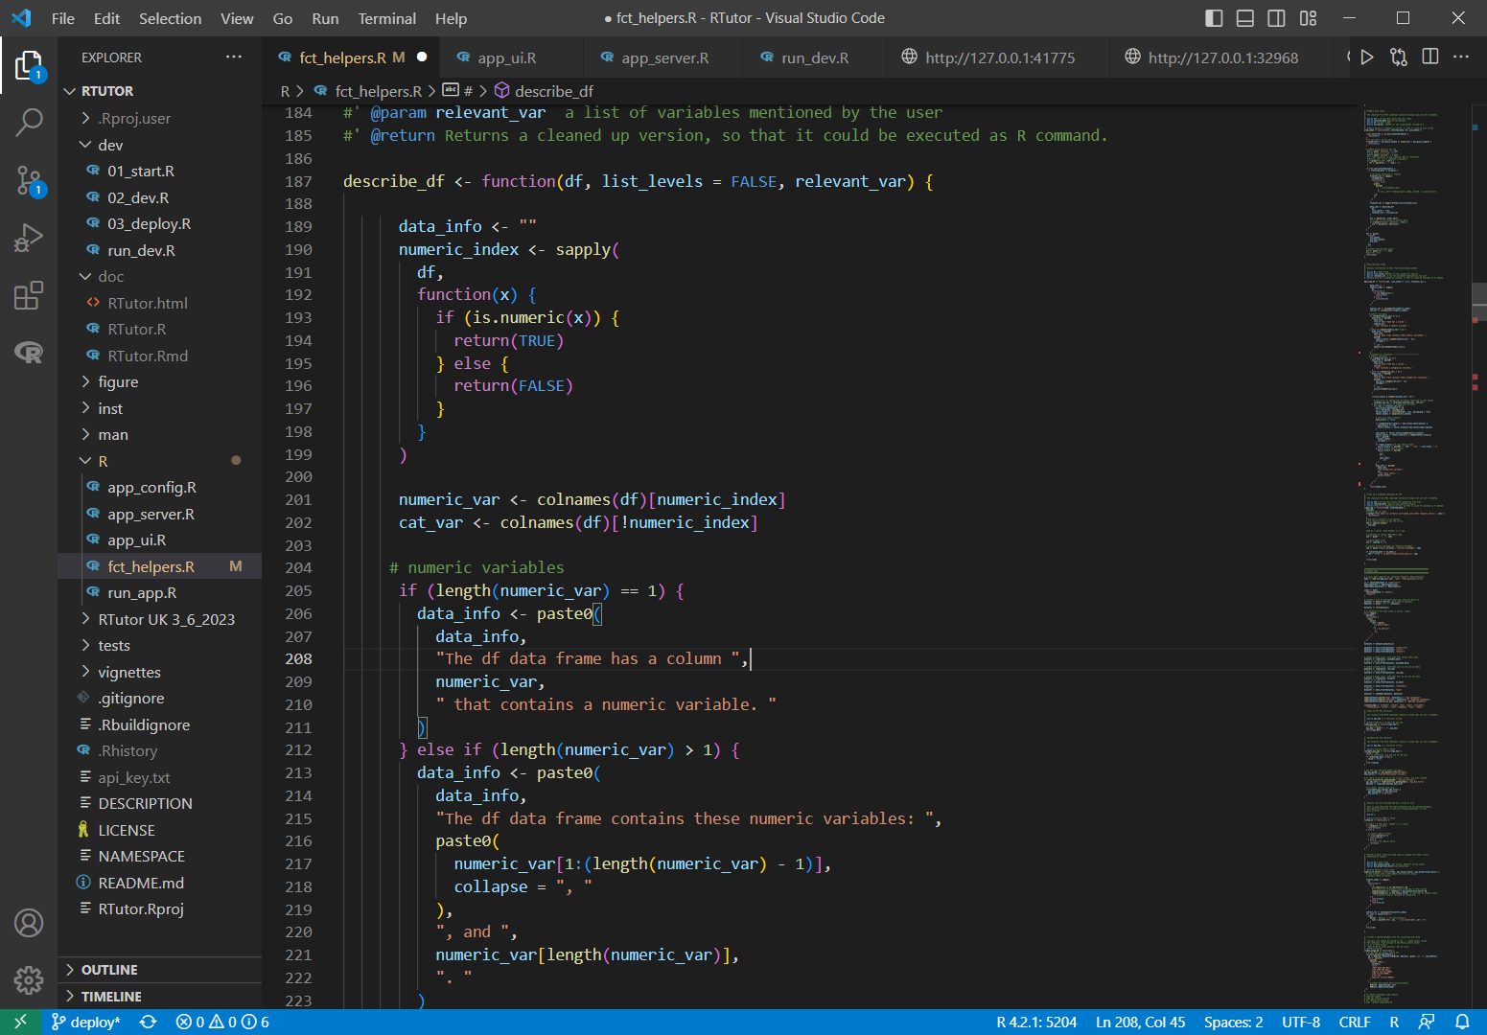
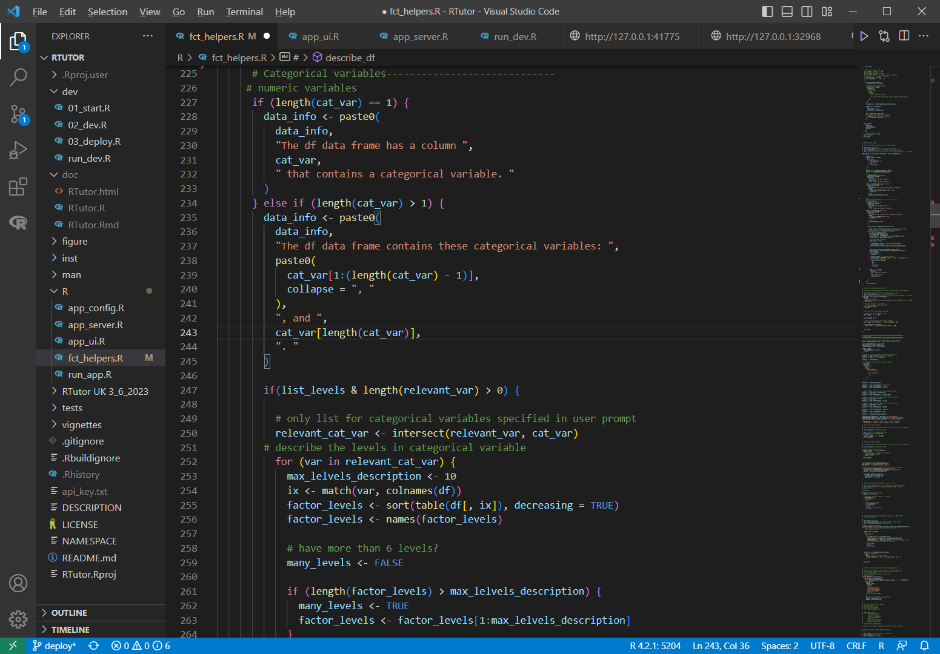
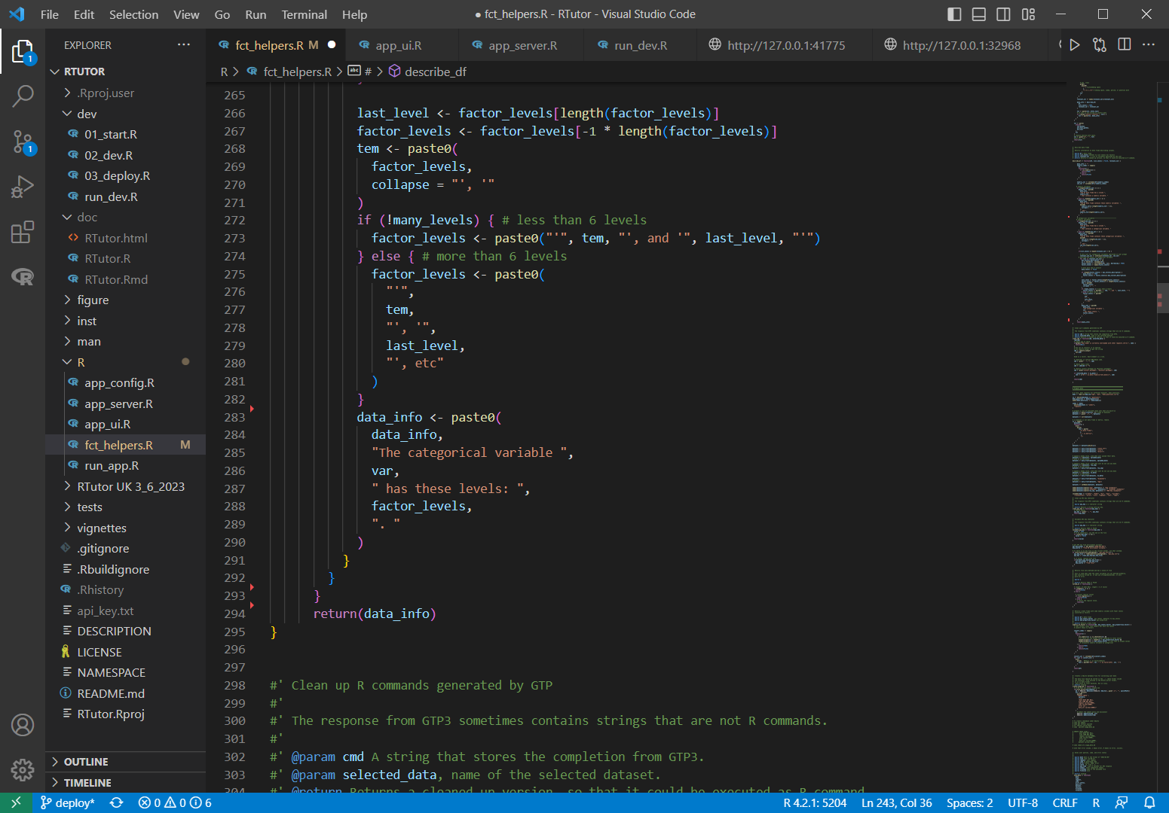
1
3
2

Slide 38
☑
1. Write a Shiny app. Create a selectInput button to select one of the values from the species column from this table:
species id
a 1
b 3
c 3
2. Great. Now add an action button, which can be clicked to show the same data frame using the data.table package. When you click on the rows, the selectInput created above is updated with the selected value.
3. Error: could not find function "on“
4. That worked. Can you hide the selectInput?
☒
☑
☑

Slide 39
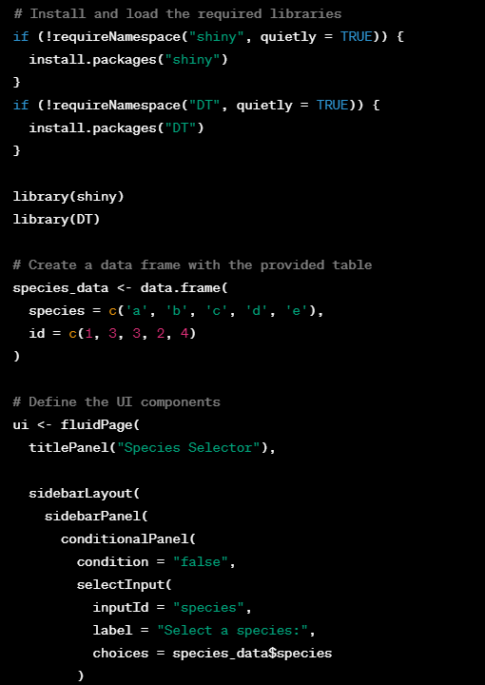
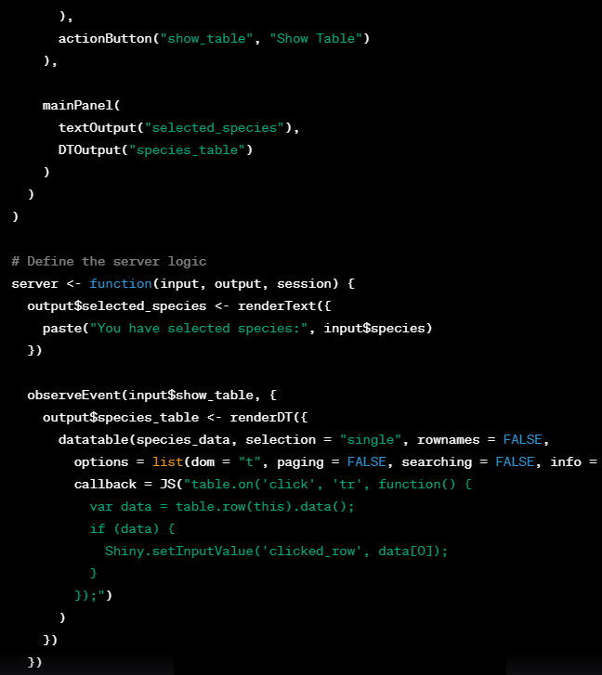
JavaScript???

Slide 40
Activity 7 Shiny app
Create a shiny app. When I upload a file, the first few rows of the data are shown.
Upload the file : GSE3770_sailfish.csv
Do you want to have coffee?

Slide 41
Activity 8
Treat the first columns as row names. Create a boxplot for all other columns.

Slide 42
Activity 9: DESeq2 workflow
Use the prompts.docx file and the GSE37704_sailfish.csv file.
In ChatGPT + RStudio or Chatlize.ai
Read Data
Gene annotation
Pre-process
Heatmap
PCA
GO enrichment
DEGs
DESeq2
See results

